Slide 1
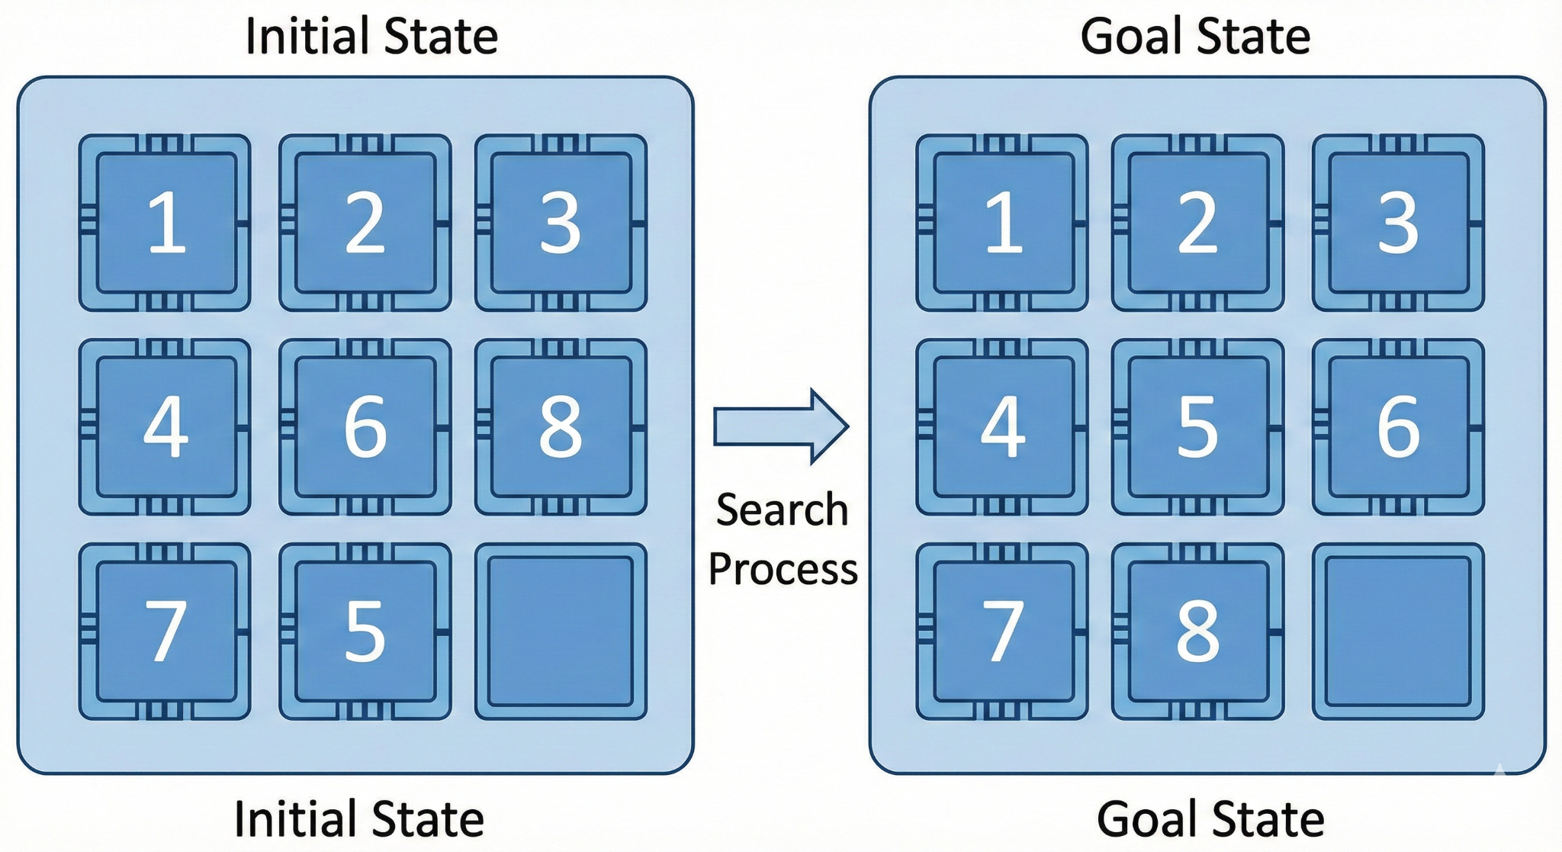
8-puzzle problem
<//
//>
Defining the problem:
The 8-puzzle is a classic problem in Artificial Intelligence used to benchmark search algorithms. It consists of a 3x3 matrix with eight numbered tiles and one blank space.
Defining the objectives:
The objective is to transform the Initial State (the scrambled board) into the Goal State (the ordered board) by moving the blank square using the minimum number of moves.
Notes:
٨

Slide 2
Solving 8-puzzle problem
<//
//>
We will compare three algorithms to solve this problem.
The three algorithms:
1- BFS
2- DLS
3- A*
Performans majors:
1- Completeness
2-Space Complexity
3- Execution Time
4- Optimality
Notes:
٨

Slide 3
BFS
BFS is an uninformed search algorithm that explores the state space systematically. It expands all nodes at the current depth level before proceeding to nodes at the next depth level. It utilizes a FIFO (First-In, First-Out) queue to manage the frontier.
It expands the nodes level by level from left to right

Slide 4
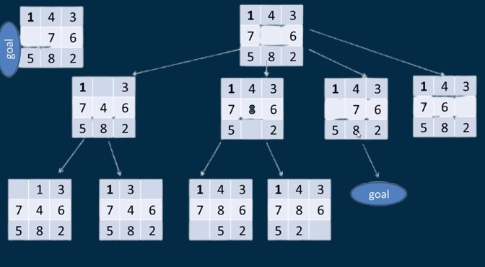
BFS
How the algorithm work

Slide 5
BFS
Performance majors
1- Completeness:
BFS is guaranteed to find a solution if one exists, as it systematically explores every possible state at each depth level.
2- Space Complexity:
High (Exponential O(b^d)). This is the main drawback. BFS must store all expanded nodes in memory (the entire frontier) to explore the next level, consuming a significant amount of RAM.

Slide 6
BFS
Performance majors
2- Execution Time::
Since it is a "blind" search, it may visit a massive number of unnecessary nodes before reaching the goal, making it time-consuming for deep solutions.
3- Optimality:
BFS is optimal in unweighted graphs.
BFS always finds the solution with the minimum number of steps. Since all steps cost the same, the shortest path in terms of steps is also the lowest-cost path.

Slide 7
DLS
DLS is an uninformed search algorithm that explores the state space using the same logic as DFS but with a predetermined depth limit. It proceeds along a single branch until it reaches a dead end or the cutoff depth, at which point it treats the node as having no successors and backtracks. Unlike standard DFS, it avoids infinite loops but is incomplete if the goal lies beyond the specified limit.
It expands the nodes branche by branche from left

Slide 8
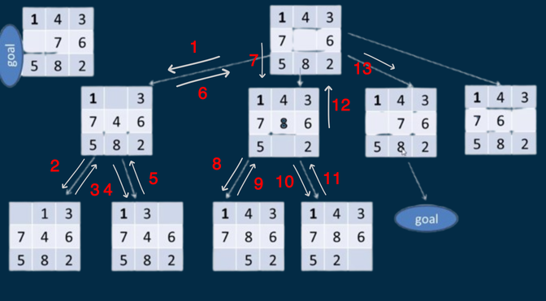
DLS
How the algorithm work
Depth = 2

Slide 9
DLS
Performance majors
1- Completeness:
DLS is Generally Incomplete. If the shallowest goal state lies at a depth d that is deeper than the pre-defined limit l (i.e., d > l), the algorithm will cut off the search and fail to find the solution. However, in the specific case of the 8-puzzle, DLS becomes Complete if the depth limit is set to 31 (the diameter of the state space).
The trade-off is that if the actual solution is shallow (e.g., d=4) but the limit is high (l=31), the algorithm may become highly inefficient. It might waste significant time exploring wrong paths down to depth 31 before stumbling upon the shallow solution in a later branch.
2- Space Complexity:
This is the primary advantage of DLS. It has Linear Space Complexity (O(b x l)), where b is the branching factor and l is the depth limit. Unlike BFS, it does not need to store the entire frontier. Instead, it only requires memory to store the current path from the root to the leaf, along with the unexpanded sibling nodes for each node on that path.

Slide 10
DLS
Performance majors
3- Execution Time::
It depends heavily on the limit and the order of branches. Like BFS, it is uninformed and may waste time exploring wrong paths within the limit.
4- Optimality:
DLS is Not Optimal. Even if the algorithm finds a solution, it is not guaranteed to be the shortest path (minimum number of steps).

Slide 11
A*
A* is an informed search algorithm that explores the state space by evaluating nodes based on a total cost function f(n) = g(n) + h(n). It combines the actual cost to reach a node (g) with a heuristic estimate (h) to prioritize the most promising paths. Specifically, the heuristic function used in this implementation counts the number of misplaced elements (tiles that are not in their correct target position). Unlike uninformed searches, A directs the process towards the goal and guarantees finding the optimal path if the heuristic is admissible.
It expands the nodes by prioritizing the state with the lowest f-score, which is derived from the heuristic function.

Slide 12
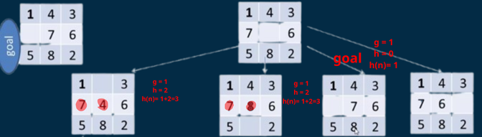
A*
How the algorithm work

Slide 13
A*
Performance majors
1- Completeness:
A* is Complete for the 8-puzzle problem. When using the heuristic function where h(n) is the count of misplaced tiles, the algorithm is guaranteed to find the solution if one exists. Unlike DLS, it never cuts off the search based on depth; it keeps checking the states with the lowest cost until the goal is reached.
2- Space Complexity:
High (Exponential O(b^d)). Similar to BFS, A* stores all generated nodes (in Open and Closed sets) to ensure optimality and prevent cycles, leading to high memory usage.

Slide 14
DLS
Performance majors
3- Execution Time::
By using a heuristic (like misplaced tiles), A* effectively prunes irrelevant branches, reaching the solution much faster than uninformed algorithms like BFS.
4- Optimality:
Optimality:A is Optimal.* It guarantees finding the shortest path (minimum number of moves) to the solution.This is achieved because the heuristic function (Misplaced Tiles) is admissible; it never overestimates the true cost required to reach the goal. Additionally, at the Goal State, the heuristic value is zero (h(n)=0), so the total cost equals the exact path cost (f(n) = g(n)). Since A* always selects the state with the lowest f-score from the queue, picking the goal confirms that no other unexplored path could possibly lead to a solution with a lower cost.

Slide 15
The final comparison
Given the specific Initial State (1, 2, 3, 4, 6, 8, 7, 5, 0) and Goal State (1, 2, 3, 4, 5, 6, 7, 8, 0), we compared the performance of DLS with max-depth 20, BFS, and A*.
Algorithm | Status | Cost(moves) | Visited nodes | Time(seconds)
DLS | solved | 14 moves | 736 | 0.0647
BFS | solved | 4 moves | 21 | 0.0002
A* | solved | 4 moves | 6 | 0.0002
So A* is the best algorithm for 8-puzzle problem

Slide 16
The final comparison in general
Performance Measure | A* | BFS | DLS
Completeness | Yes ✅ | Yes ✅ | No ❌
Space Complexity | High | Very high | low
Execution Time | Fast 🚀 | Slow 🐢 | Average
Optimality | Yes ✅ | Yes ✅ | No ❌
So A* is the best algorithm for 8-puzzle problem

Slide 17
The end
Thanks

